Slide 1
Qantas goes green
Using biofuels in commercial aviation
Thais Angeloni, Zhen Zhang, Hee Yen Zhen
The University of Queensland

Slide 2
Proposal
Stop debt
Look into future
Go green!

Slide 3
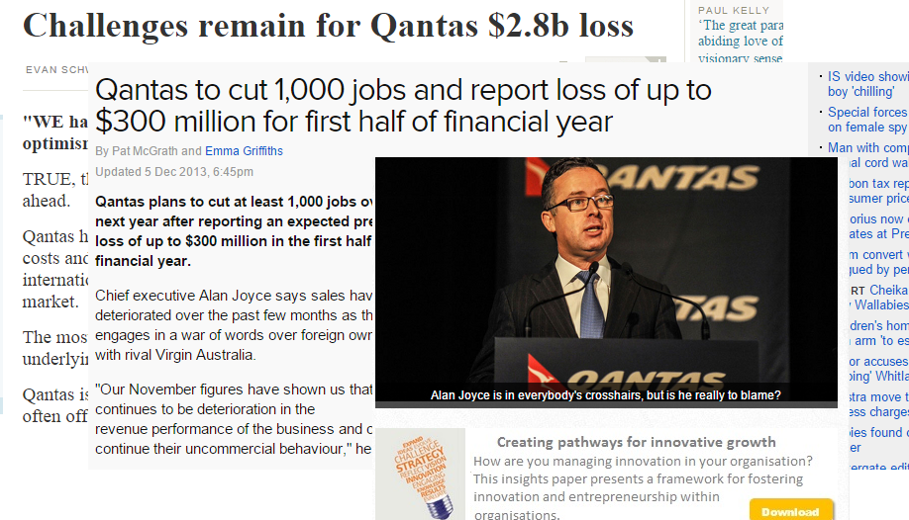
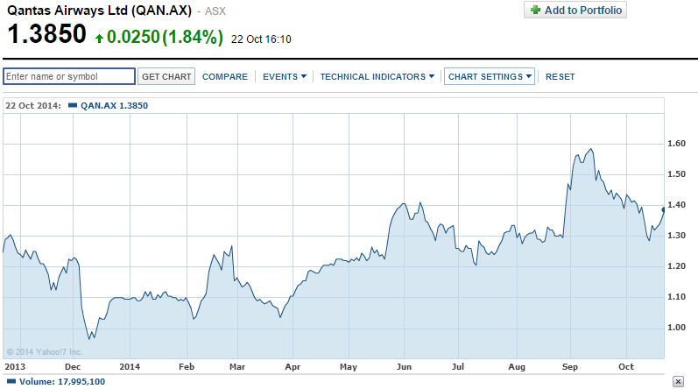
Problems
Financial loss
Cut costs to make up the losses to no avail.
Struggling to gain profit
Year | 2012 | 2013 | 2014
Fuel ($M) | 4220 | 4154 (-1.6%) | 4461 (7.4%)
Net Asset ($M) | 5889 (5468) | 5954 [1.1%] (5840) [6.8%] | (2866) [-50.9%]
Aircraft and engines | 18799 | 18486 (-1.7%) | 17131 (-7.3%)
With liquidation | 11278 | 11075 (-1.8%) | 8473 (-23.5%)

Slide 4
Yes, we can!

Slide 5
Stop debt
Managing Debts into Beneficial PROFITS
Look into future
Sustaining Long-term Investment
Go green
Ecological and Environmental Friendly

Slide 6
The use of biofuels
Drop-in fuels
Initially mix to conventional jet fuel
Increasing percentages

Slide 7
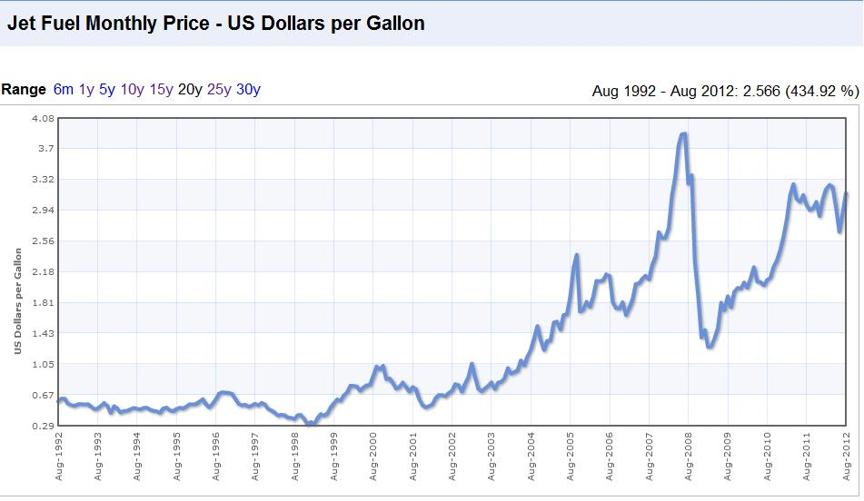
Economic viability
Reduction on carbon tax
Alternative sources of biofuel

Slide 8
The use of biofuels
Add drop-in biofuels to conventional jet fuels
Initially at low percentages (5% - 10%)
If proven successful, increase percentage
Initially in 3% of fleet (4 aircrafts)

Slide 9
Australian first 100% biofuel airline
Being ahead of innovation
Being first recognized green airline company and…
Being successful!

Slide 10
Advantages of biofuel
Economic treatment value:
More fuel efficiency
Maintaining optimal temperatures of the engines
Long term maintenance cost benefits
-Qantas Resources usages⬇, Gain Profitable Money ⬆.
→ Managing Debts to Profits!

Slide 11
Advantages of biofuel
Economic attractive value:
Reduce Australian fuel imports (>AU$2 billion/year)
Support new local clean energy company
Social value:
>12,000 clean energy Jobs
Improve Australia's Energy Security
Environmental value:
a 50% Reduction in carbon emissions by 2050
Attract more Environmental Investors and Government
Market share rise

Slide 12
Prepare for the future
Global warming
Choosing to adapt and prepare
Ensure continuous success
(Regardless of what the climate may bring)

Slide 13
One Step Ahead

Slide 14
Questions?

